Slide 1
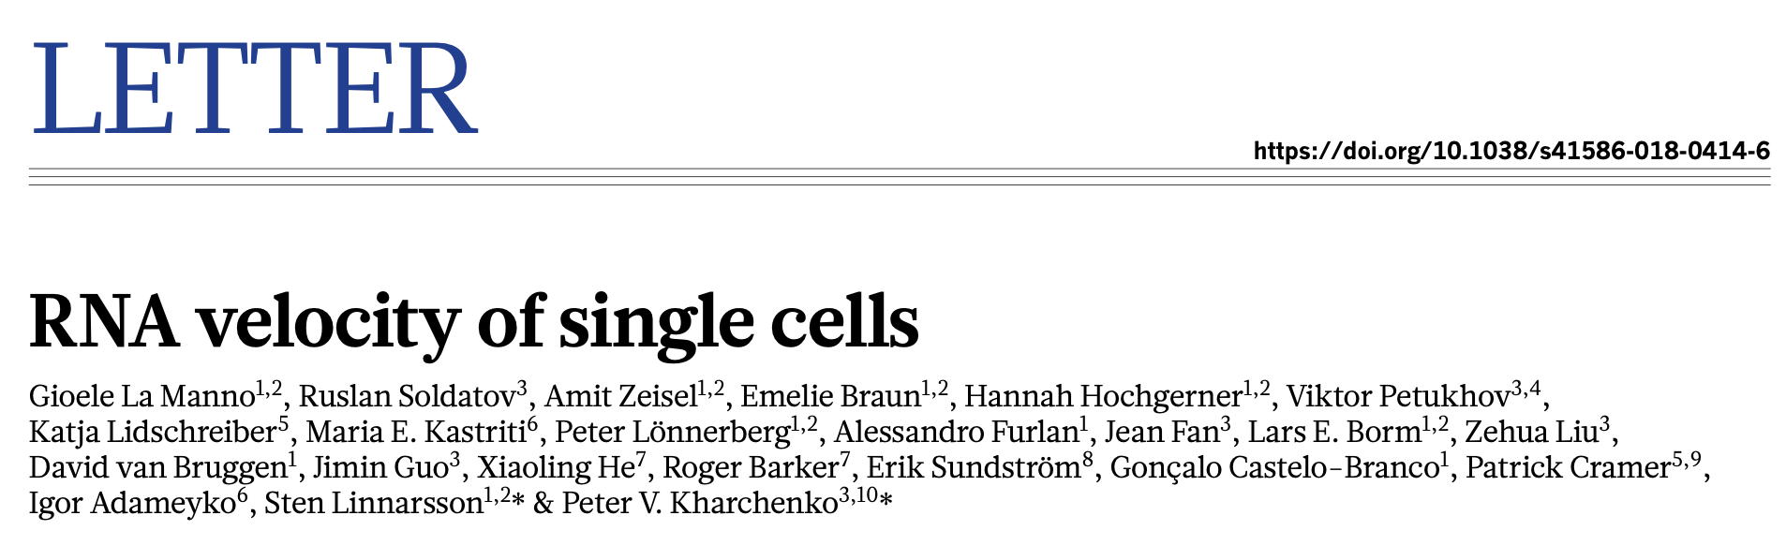
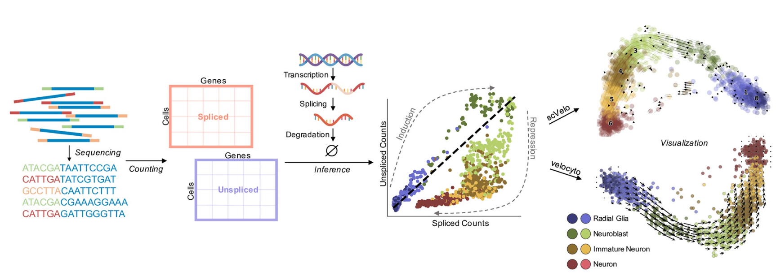
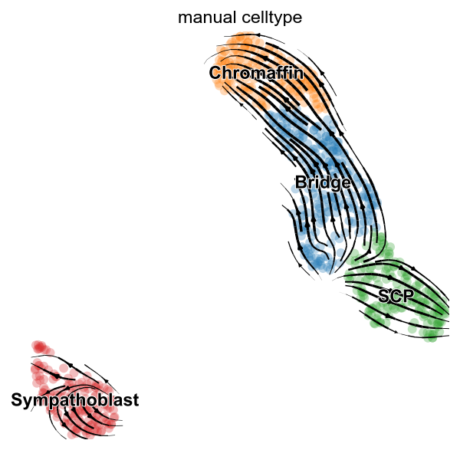
RNA Velocity
Lumi Zhang
12112618
2024.5.27
Acknowledgements:
Prof Xi Chen, Huaiyuan Ma, Xin Zheng.

Slide 2
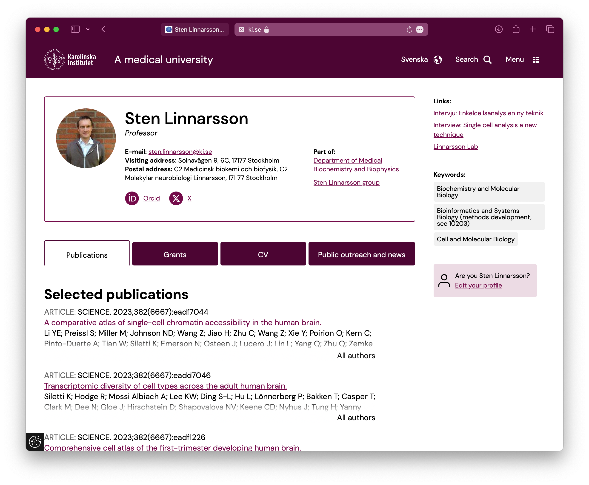
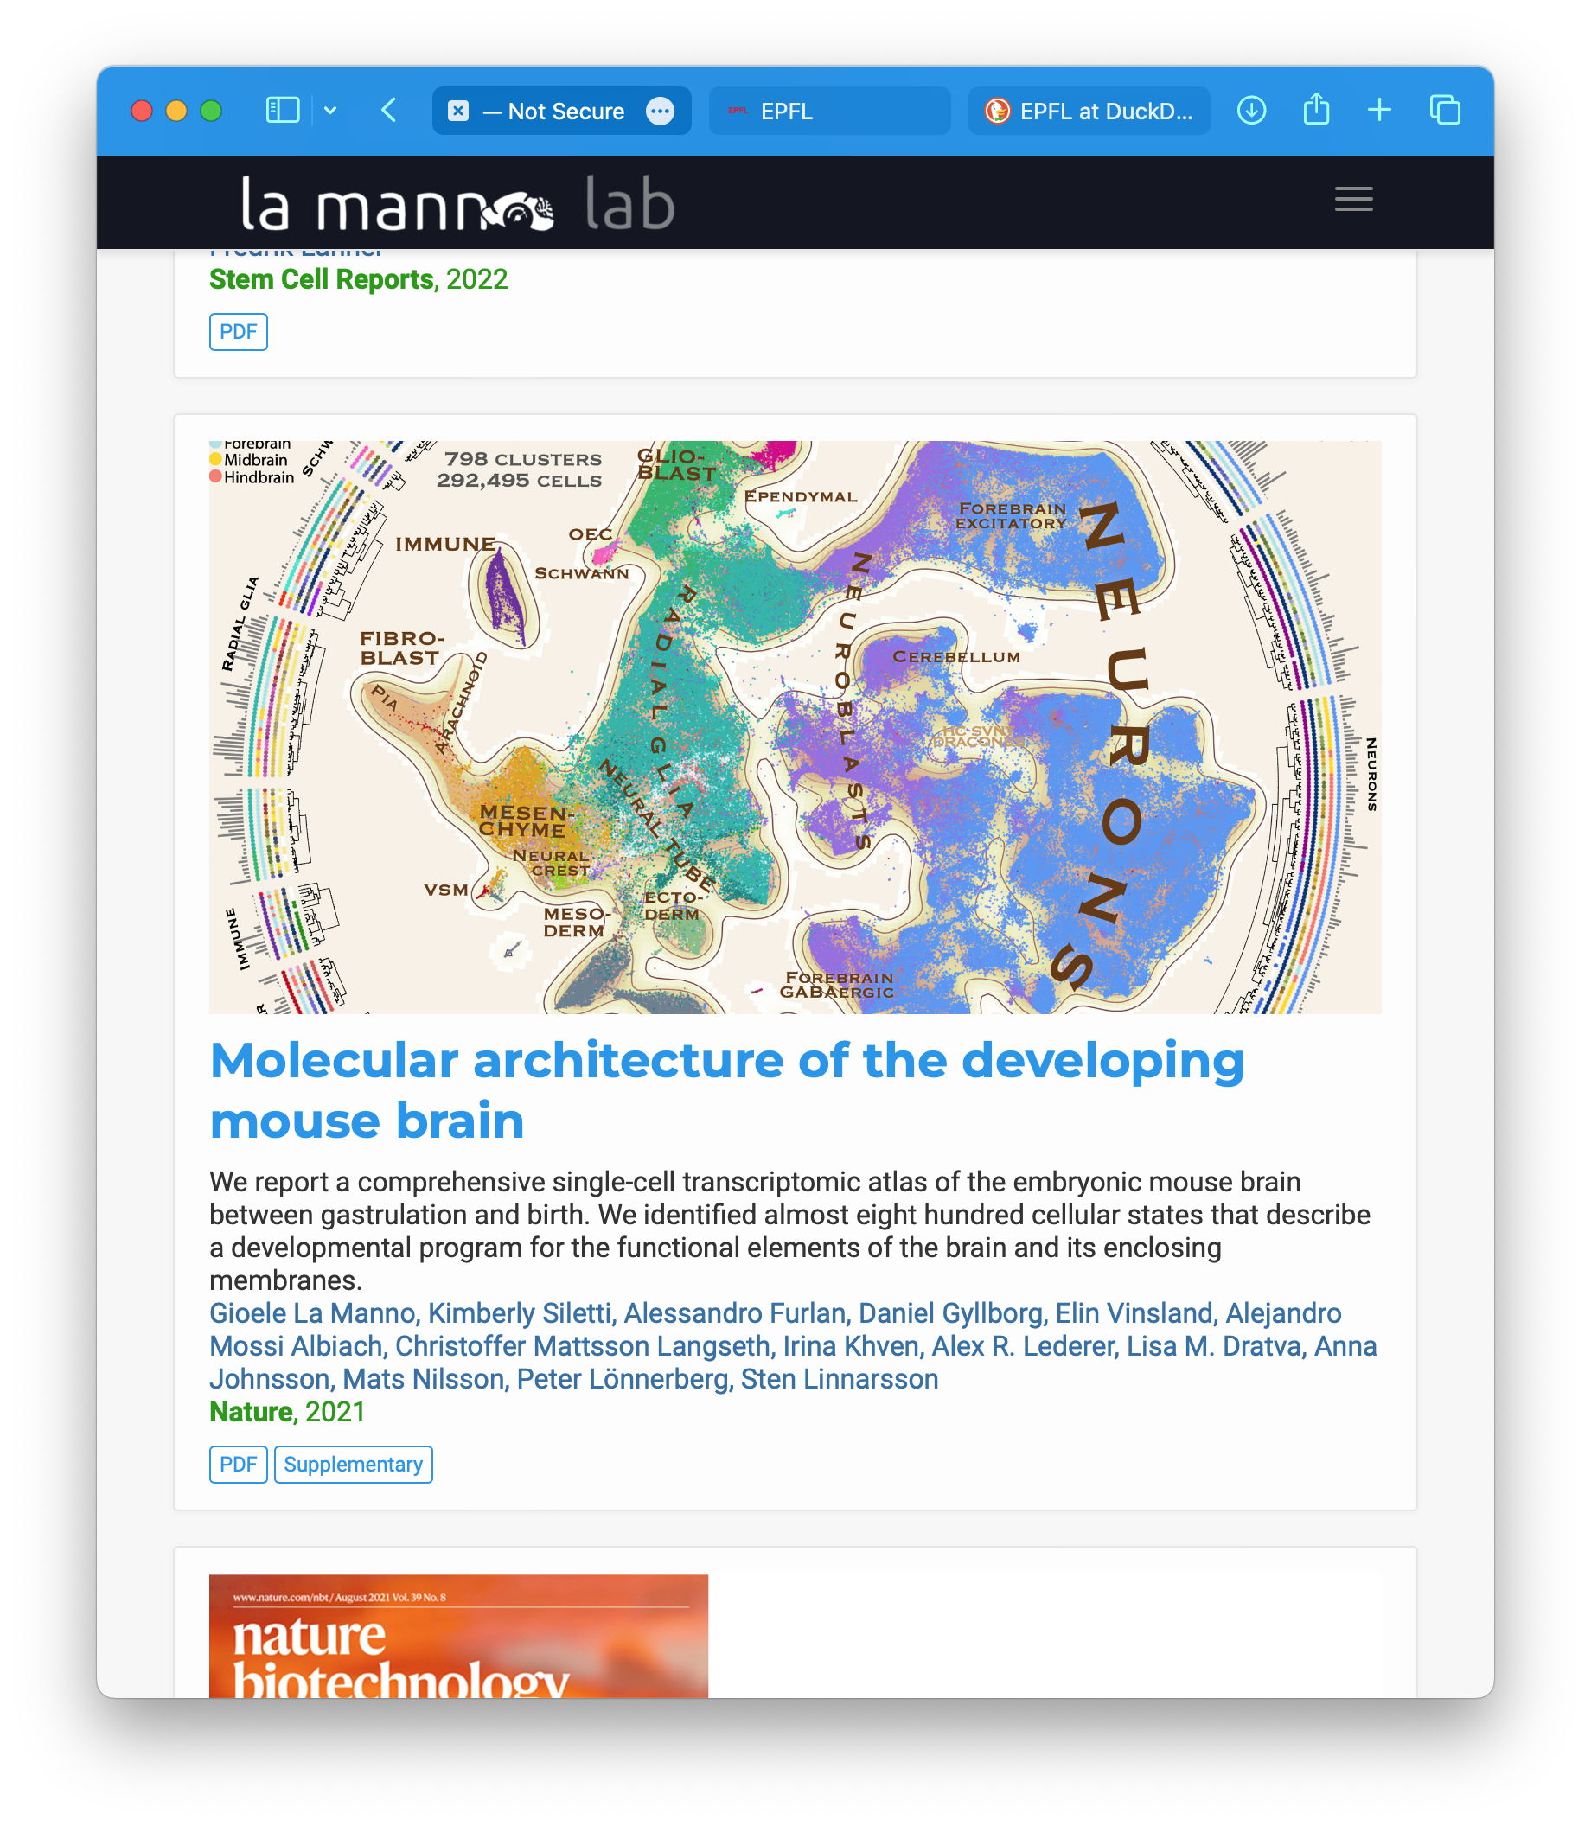
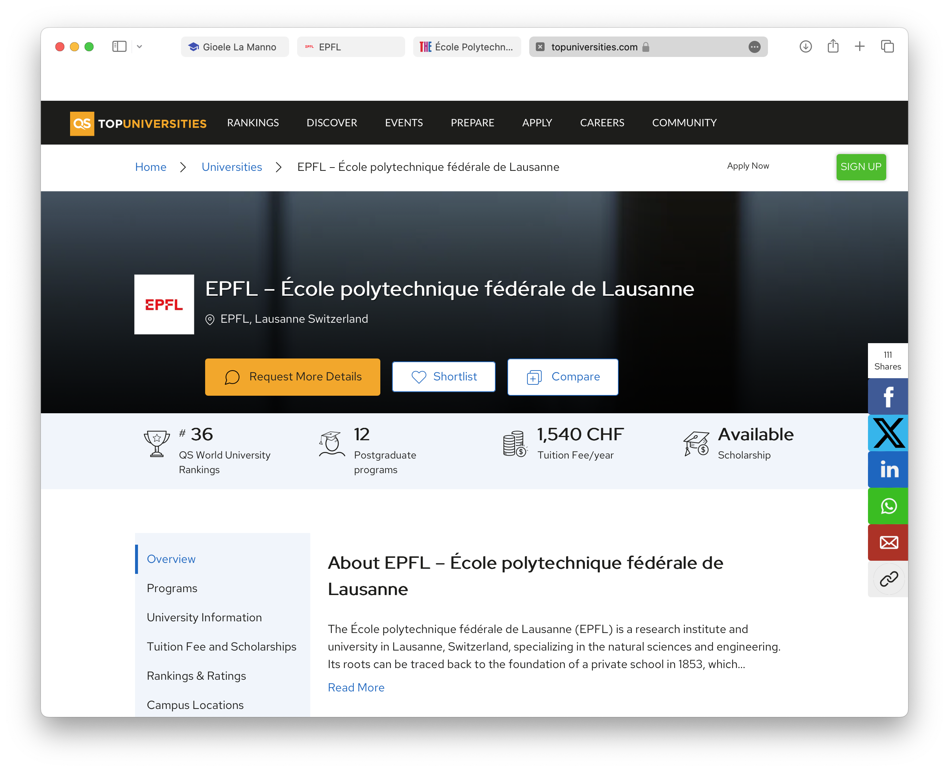
Lab Introduction

Slide 3
Model

Slide 4
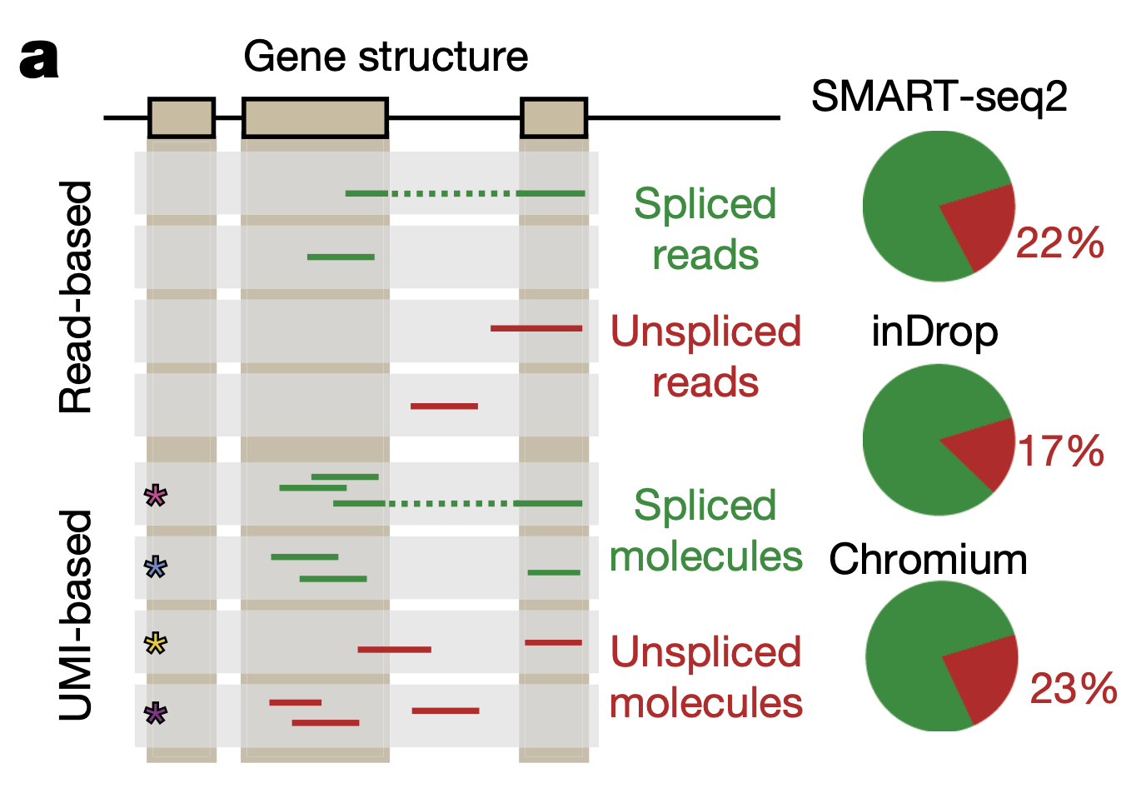
Splicing can really be detected!
Smart-seq don’t have UMIs until smart-seq3.
inDrop have UMIs
10x

Slide 5
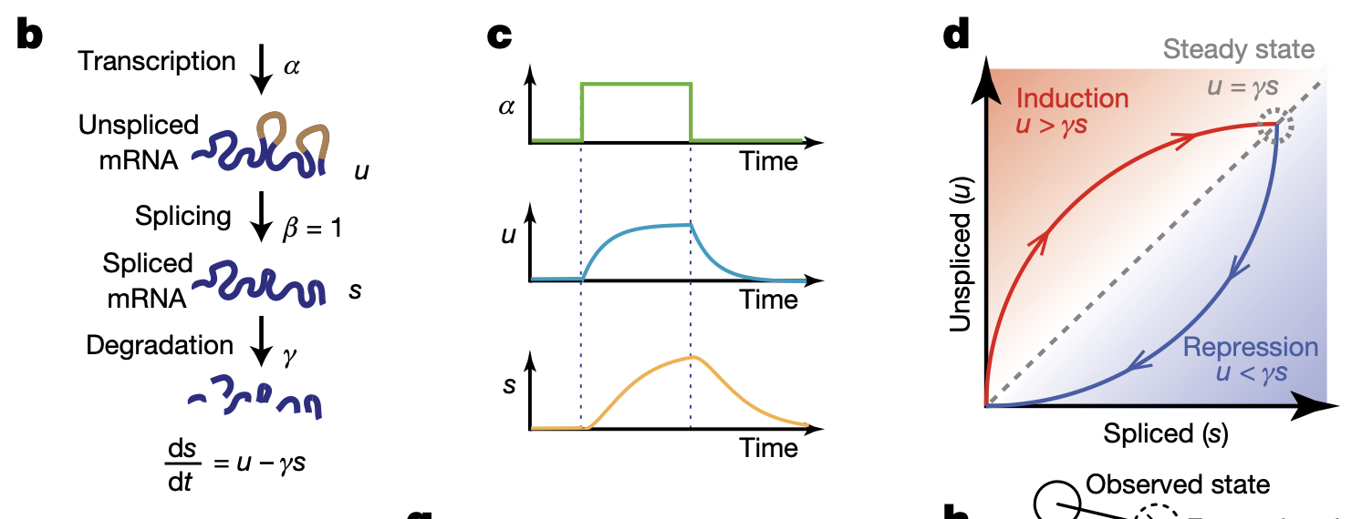
Basic Model of velocyto.

Slide 6
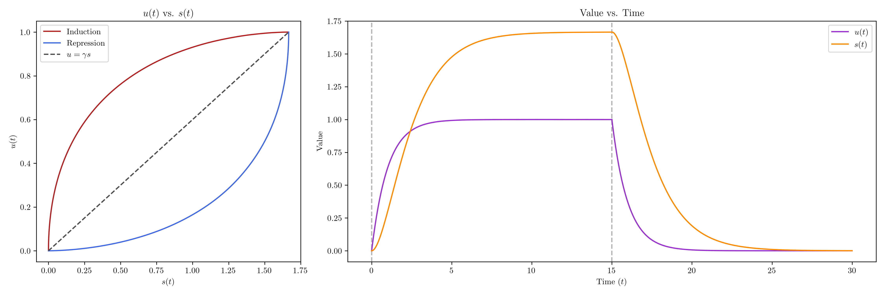
DIY calculation of phase portrait.

Slide 7
Basic workflow in RNA velocity analysis.

Slide 8
Replication of Findings Part I: Alignment

Slide 9
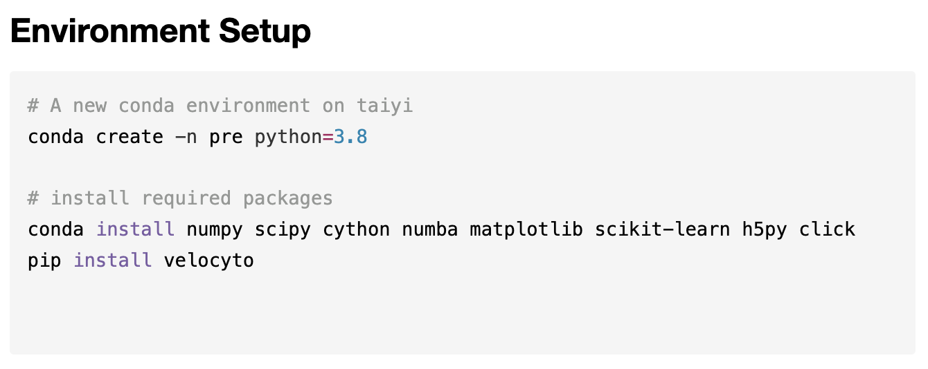
Normal Analysis
(Things started to look a bit weird, but I overcame the weird things.)

Slide 10
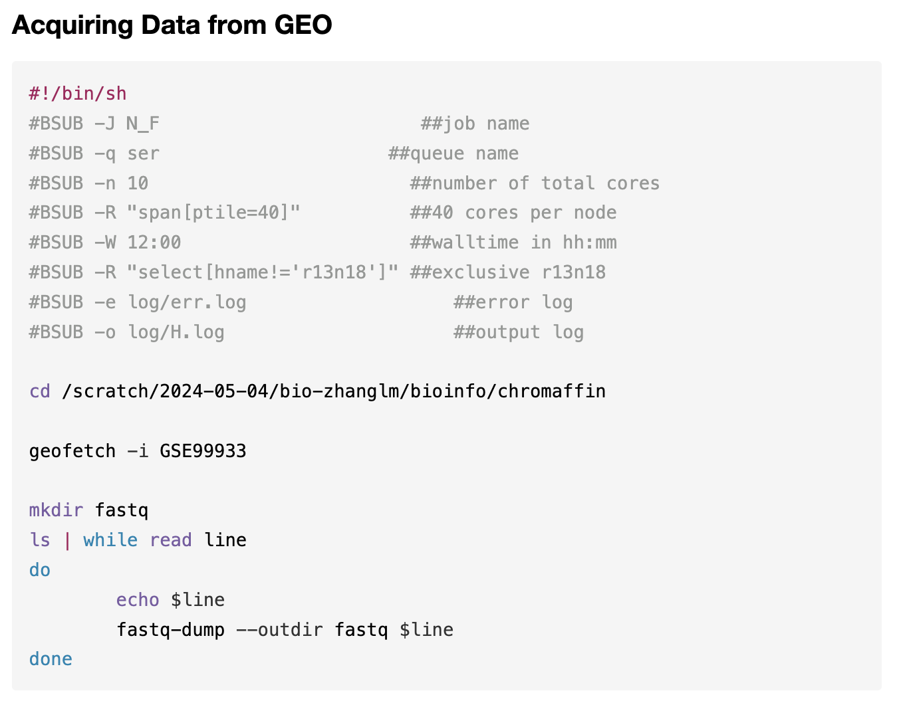
First obstacle - Data acquisition
Don’t know how long it took.
Smart-seq2 data is the only one finished.
10x Hippocampus development was huge! I gave up, Lumi out.

Slide 11
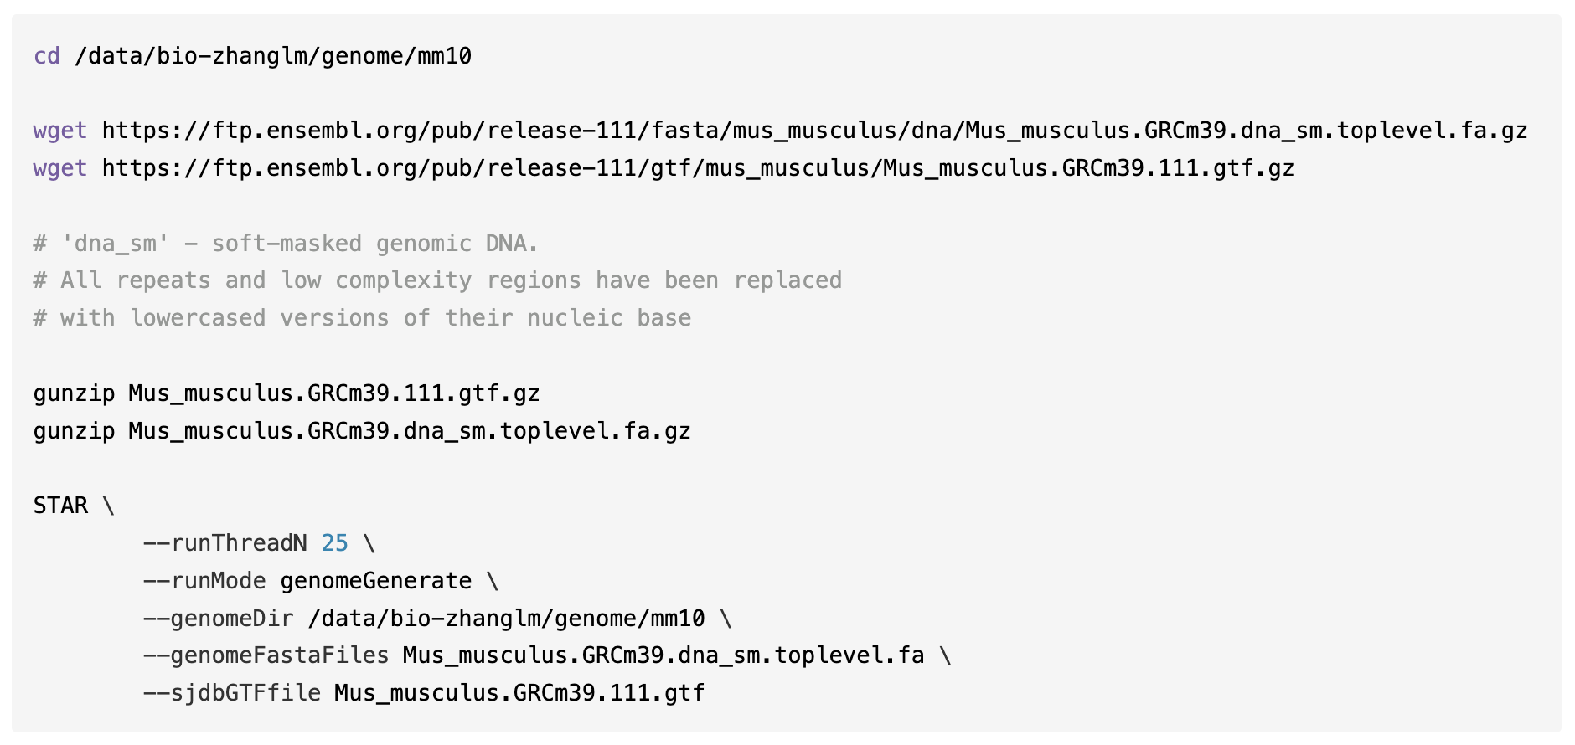
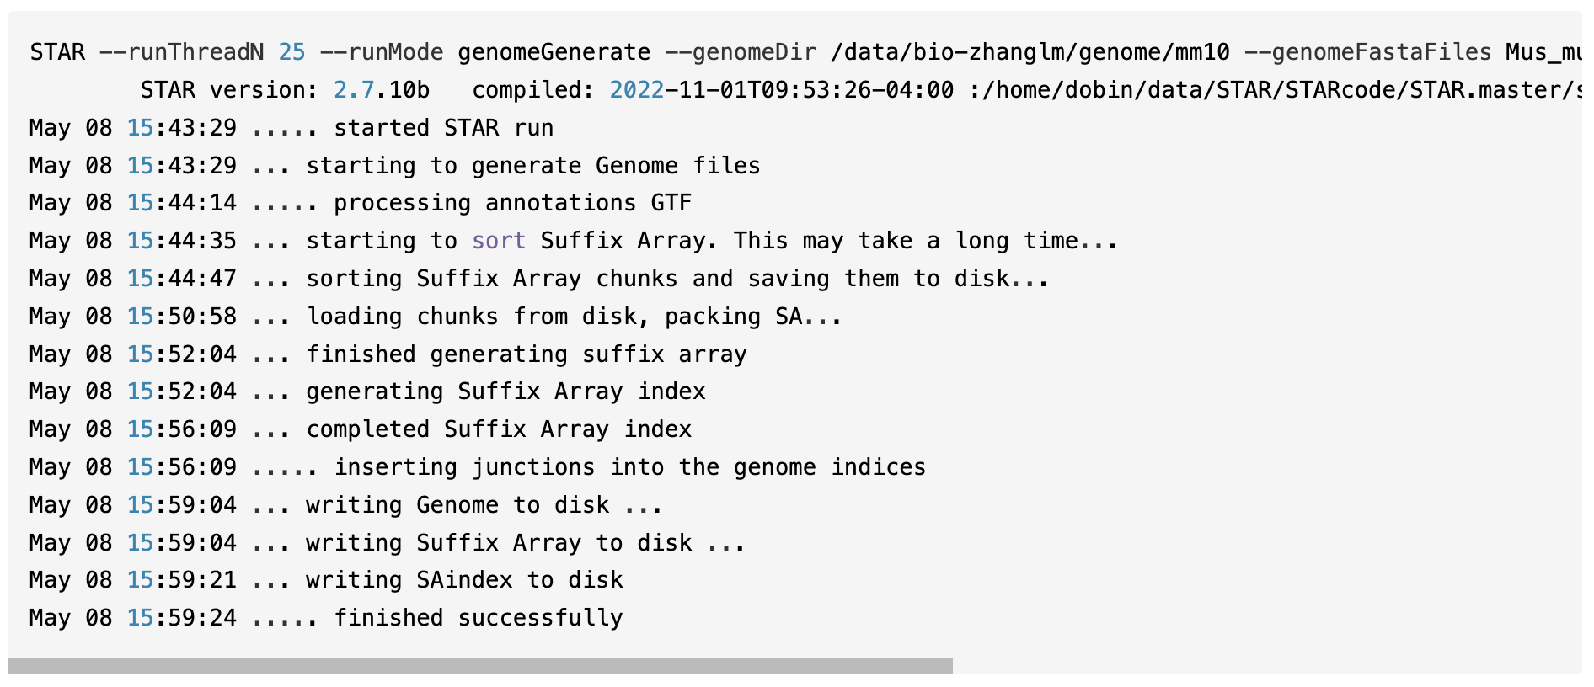
Happy indexing
Since nobody said anything about quality control and pre-processing,
it’s Alignment time!!!

Slide 12
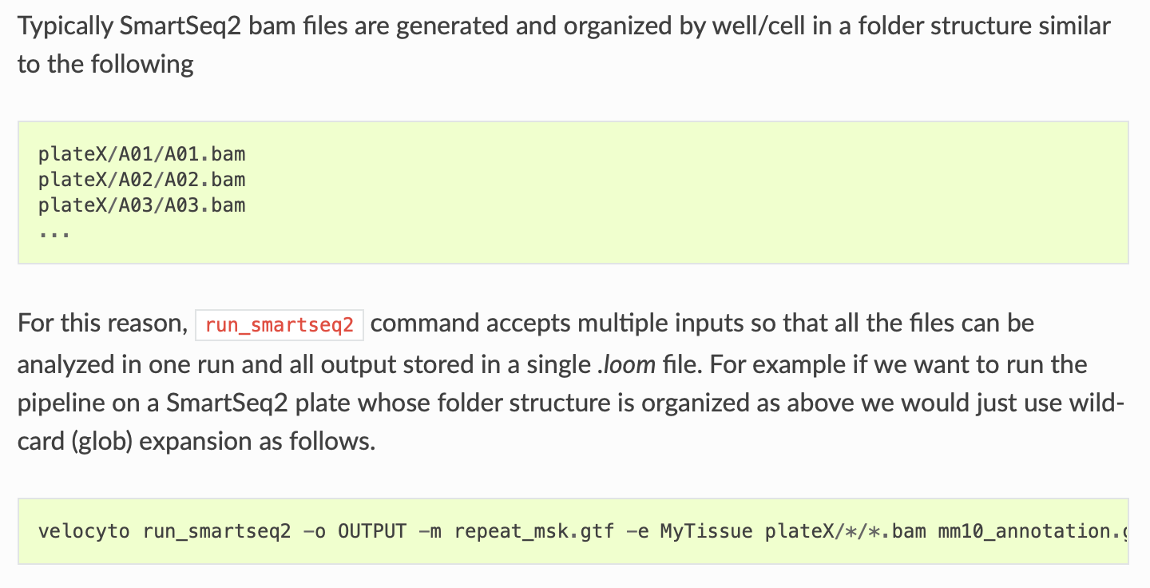
Second obstacle - Introduction

Slide 13
Second obstacle - Alignment
Trash Taiyi don’t accept one user submitting more than 52 jobs at a time.
There are freaking 700+ cells (fastq files).
We need align them.
Method 1:
Write a very simple for loop that iterate through the 700+ cells, aligning one-by-one.
Very easy but time consuming.
Method 2:
Align them all at once, and find a way to seperate them later.
Fast alignment but requires a bit of research.

Slide 14
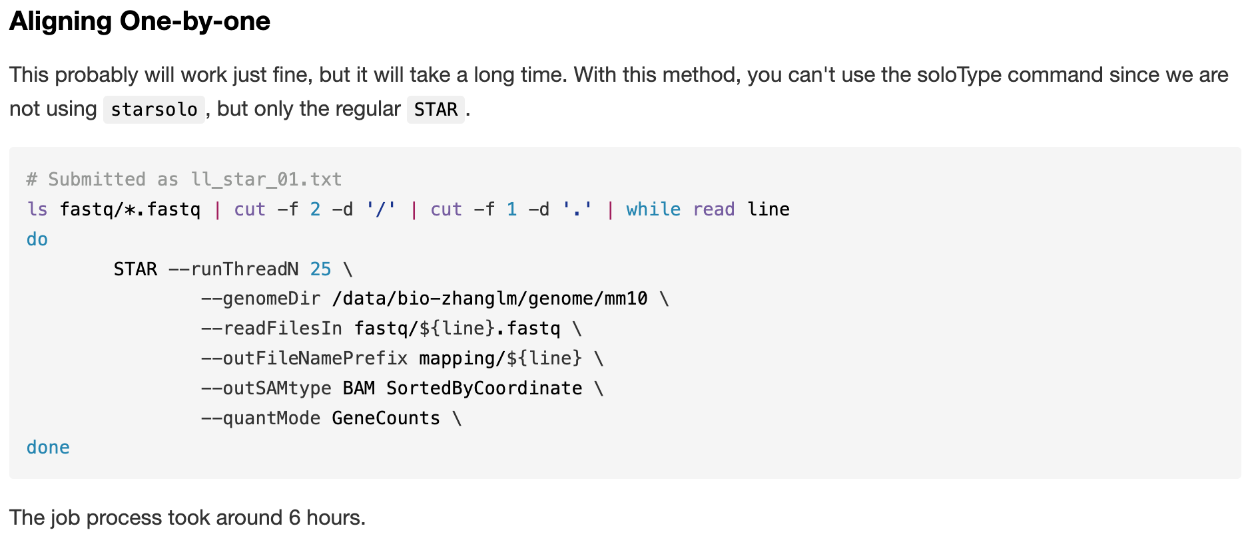
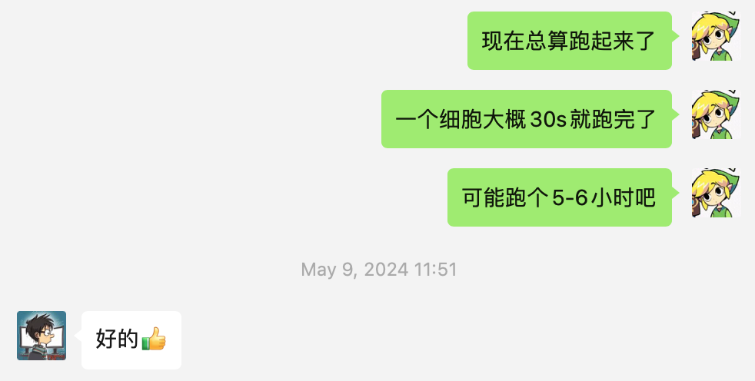
Method 1: A gigantic for loop

Slide 15
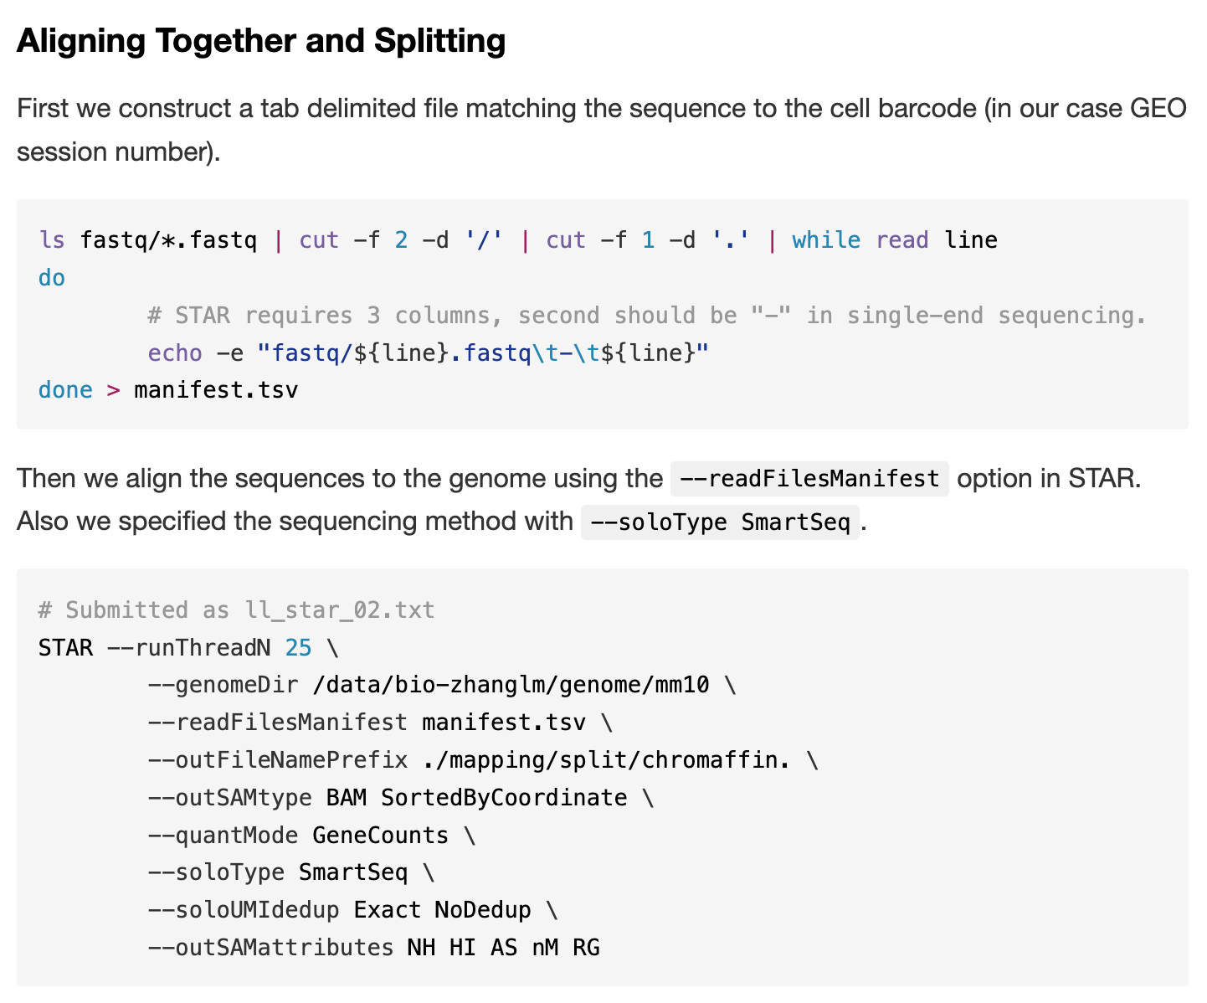
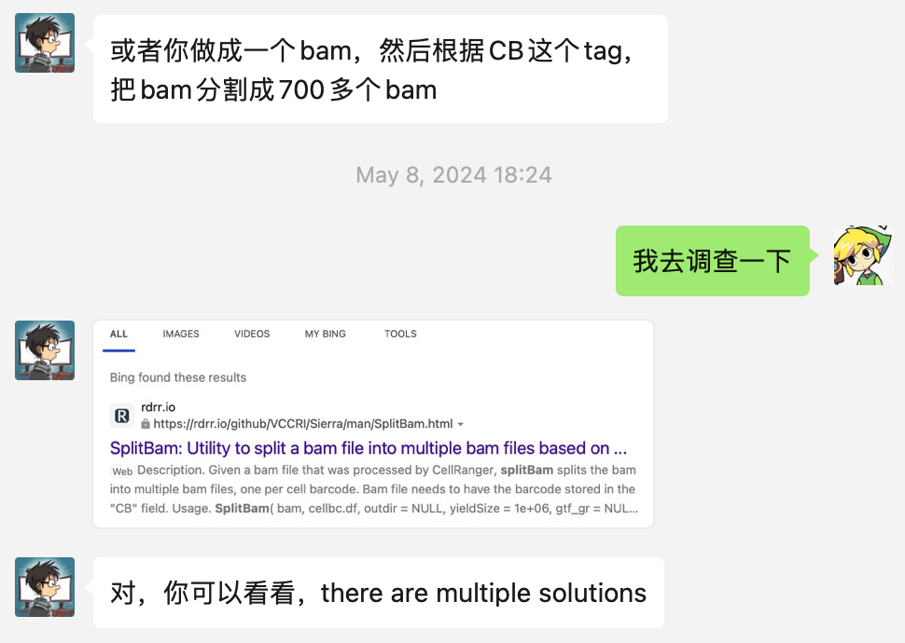
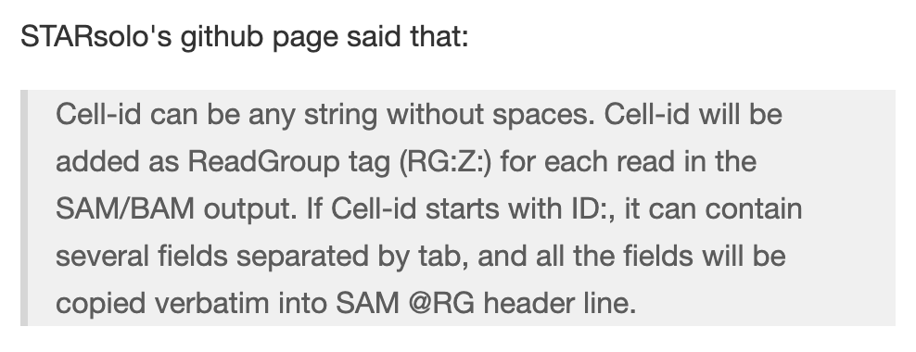
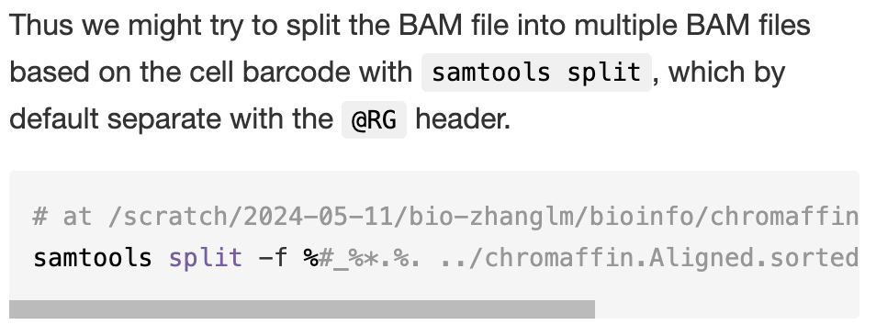
Method 2: Why not ... ?

Slide 16
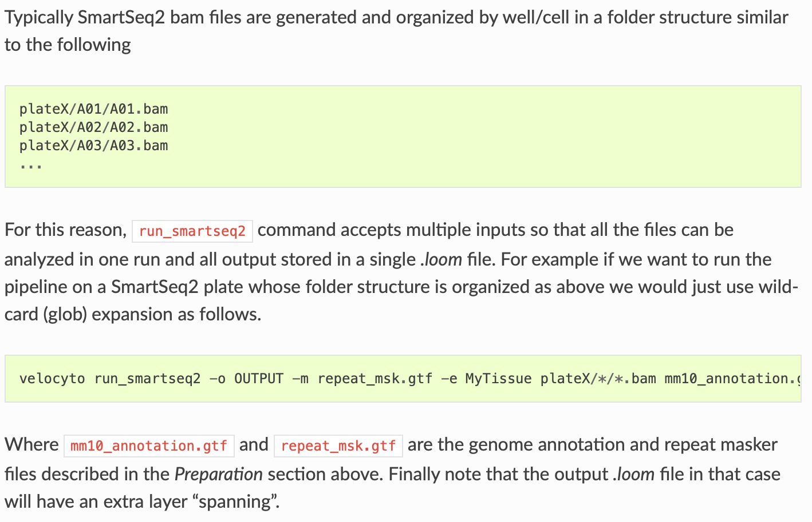
Call back:

Slide 17
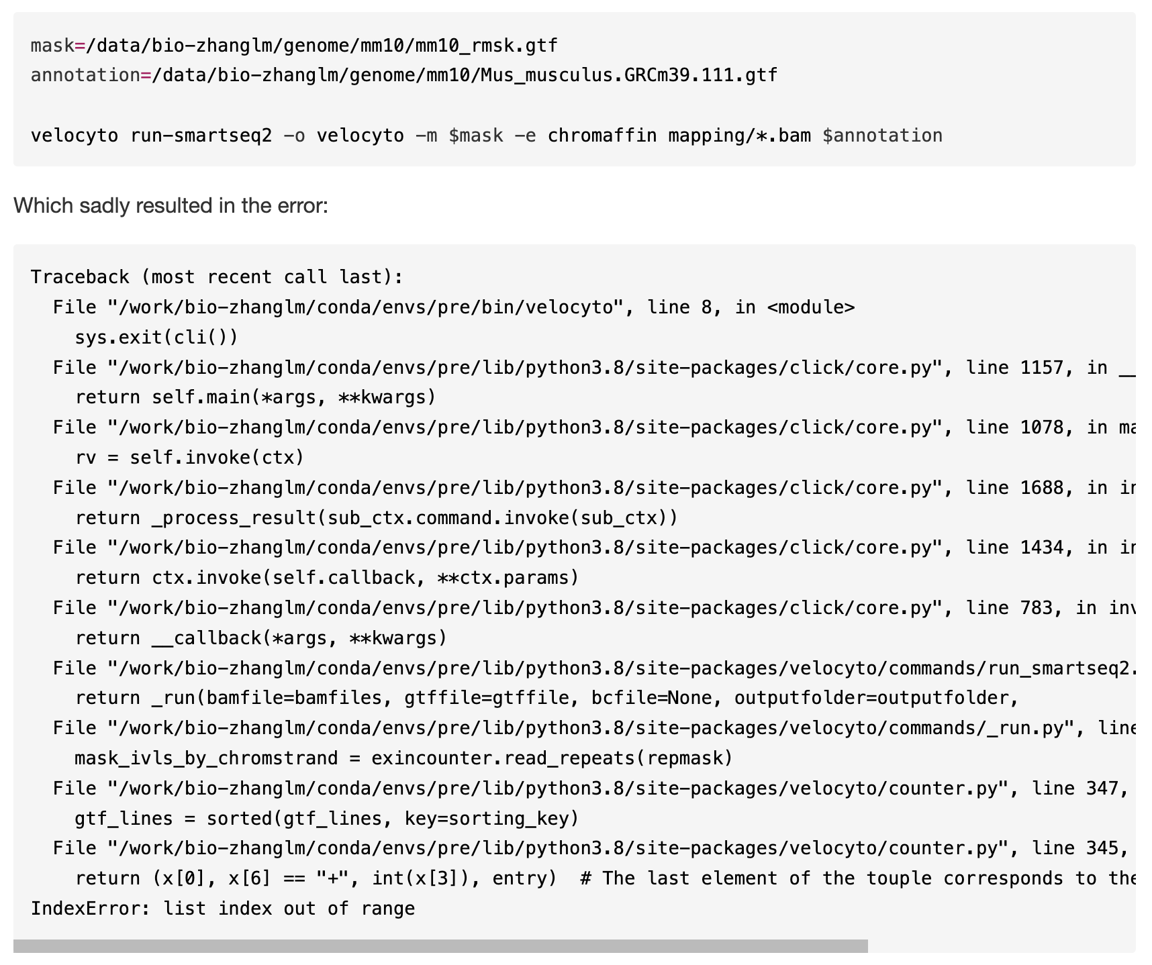
The troublesome loom file.

Slide 18
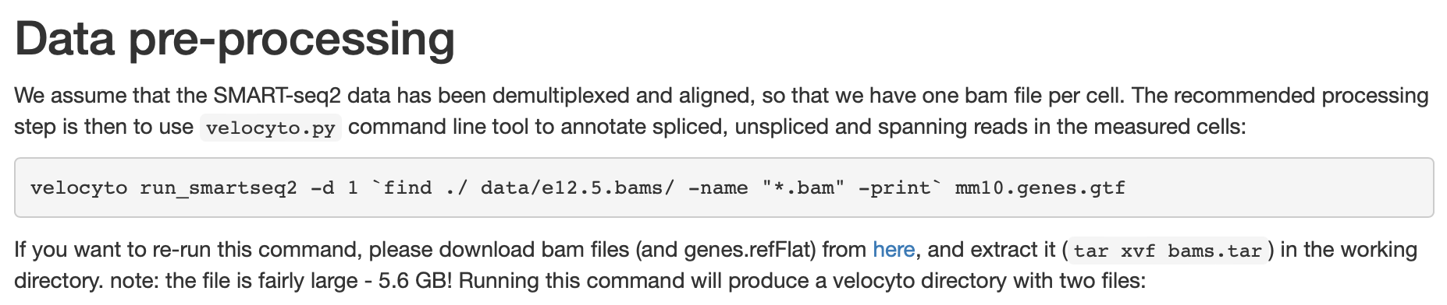
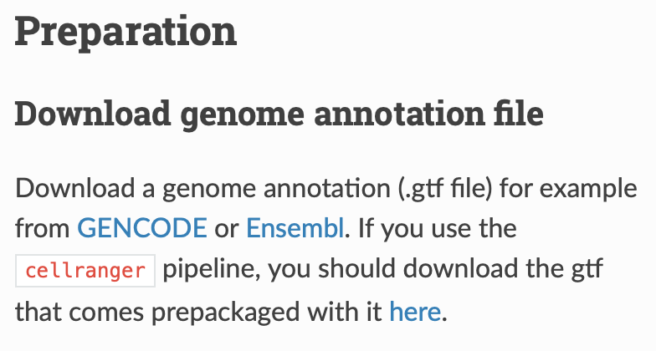
まさか...
http://pklab.med.harvard.edu/velocyto/notebooks/R/chromaffin2.nb.html#

Slide 19
Replication of Findings Part II: Analysis

Slide 20
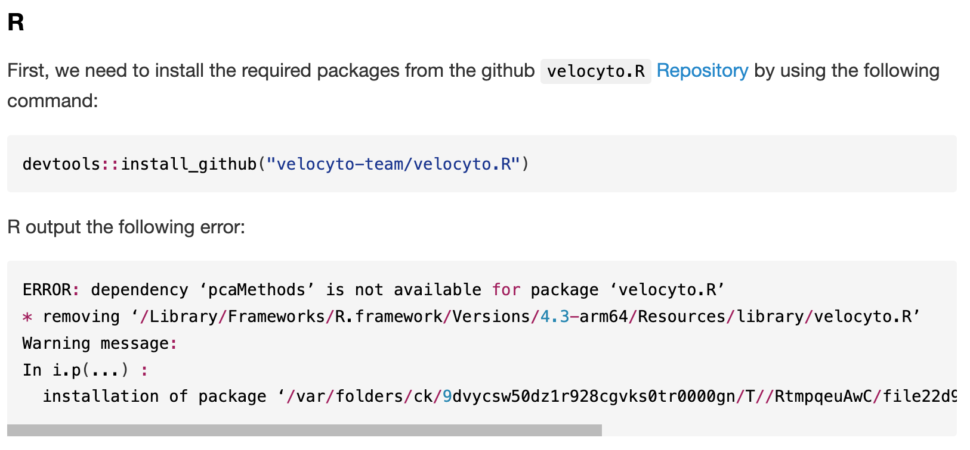
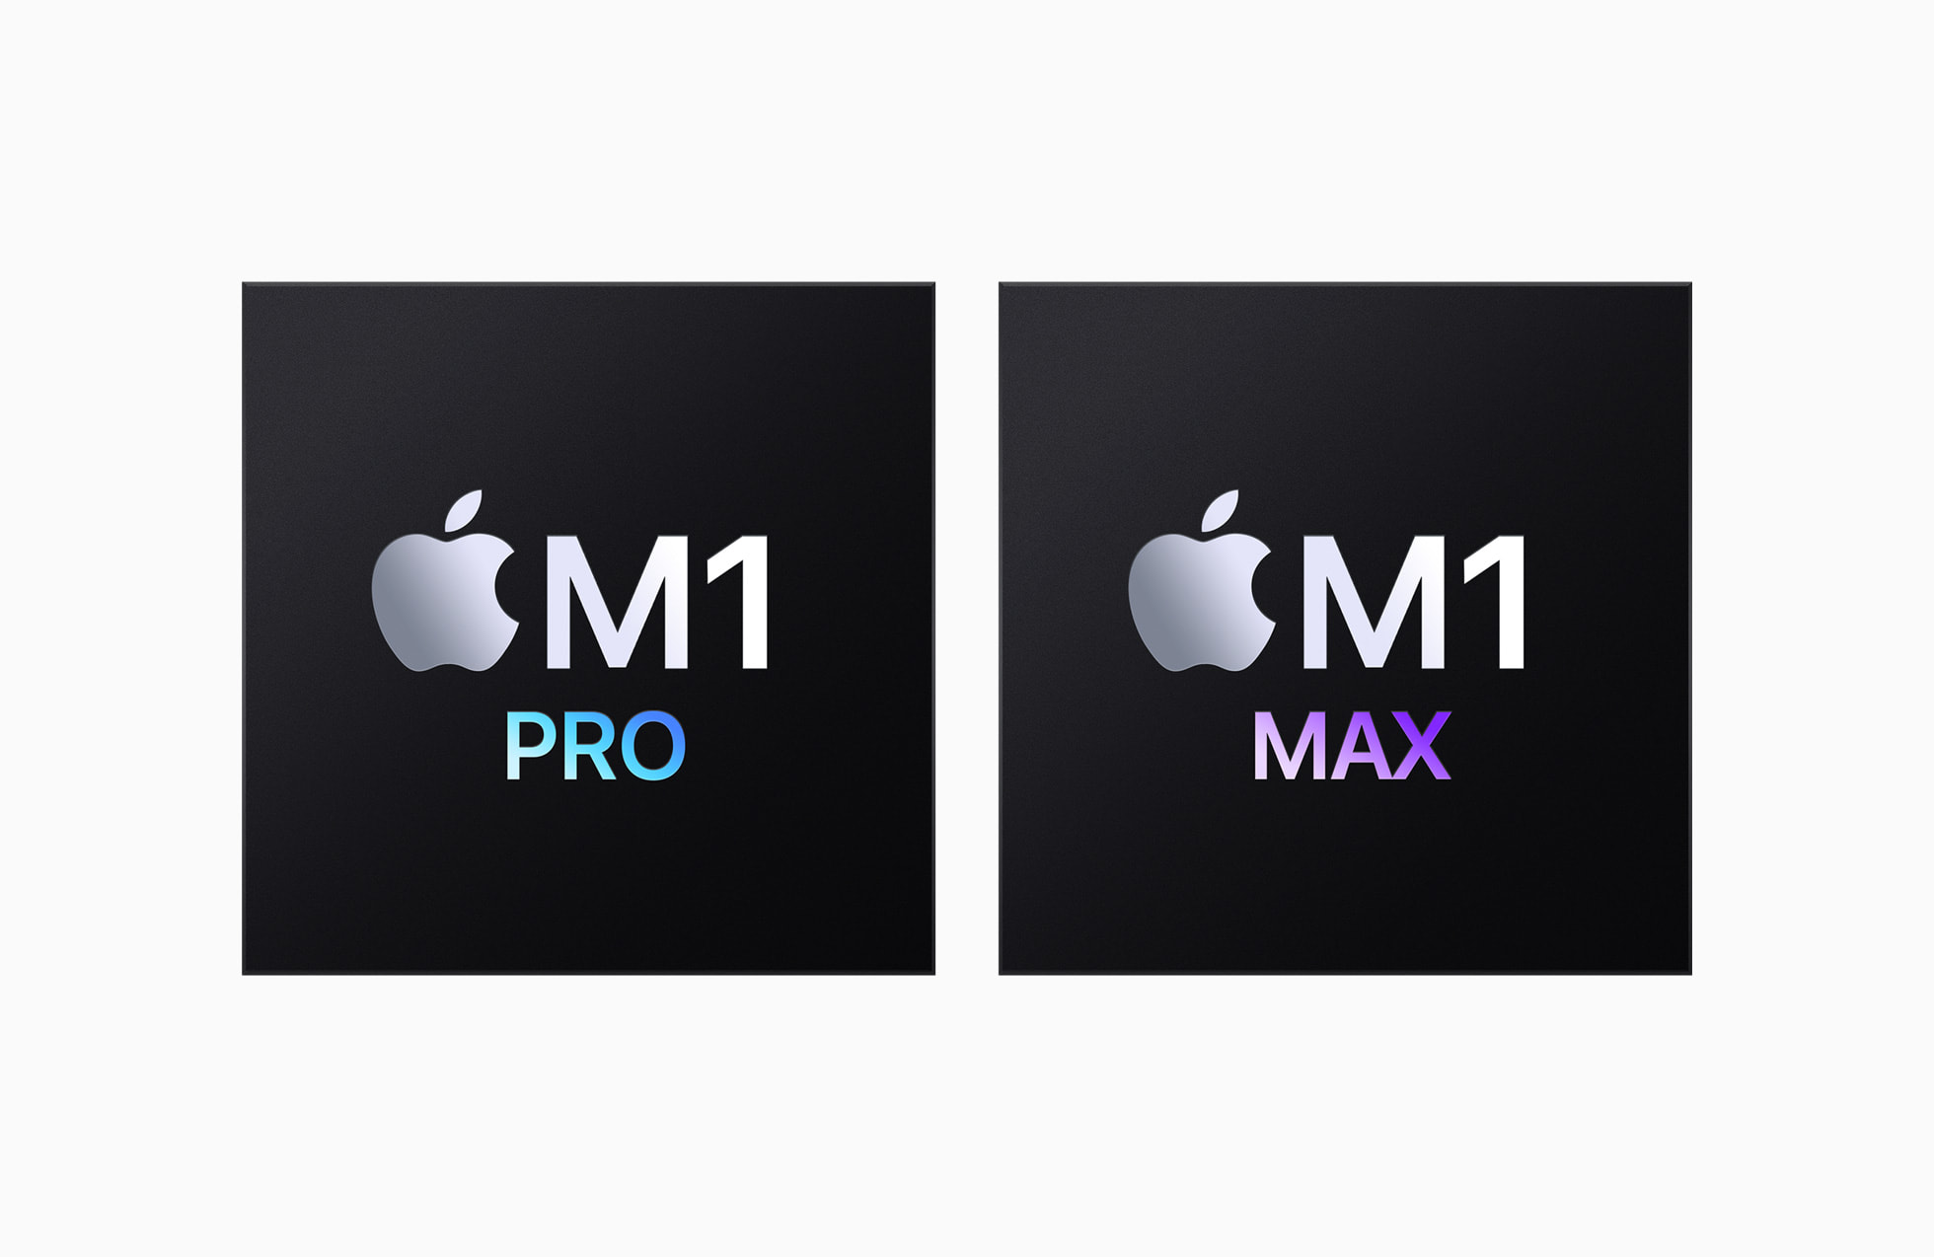


Biggest problem.

Slide 21
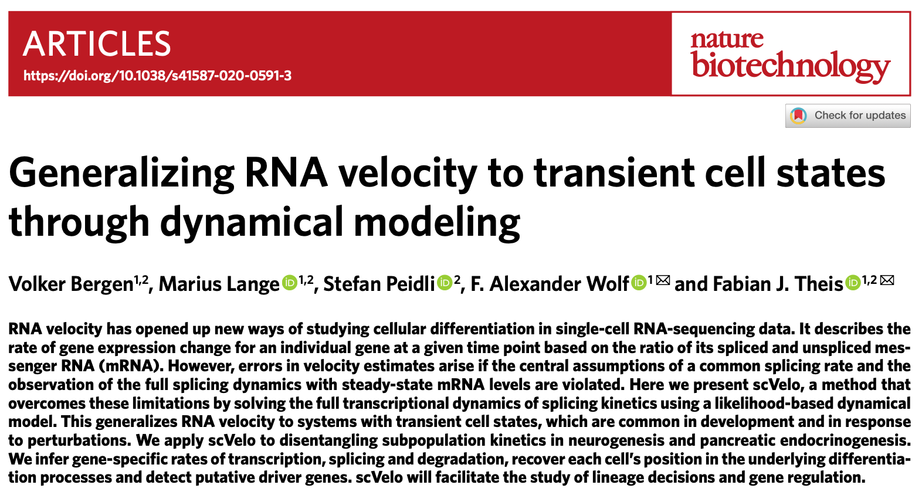

Luckily, we have a saviour!

Slide 22
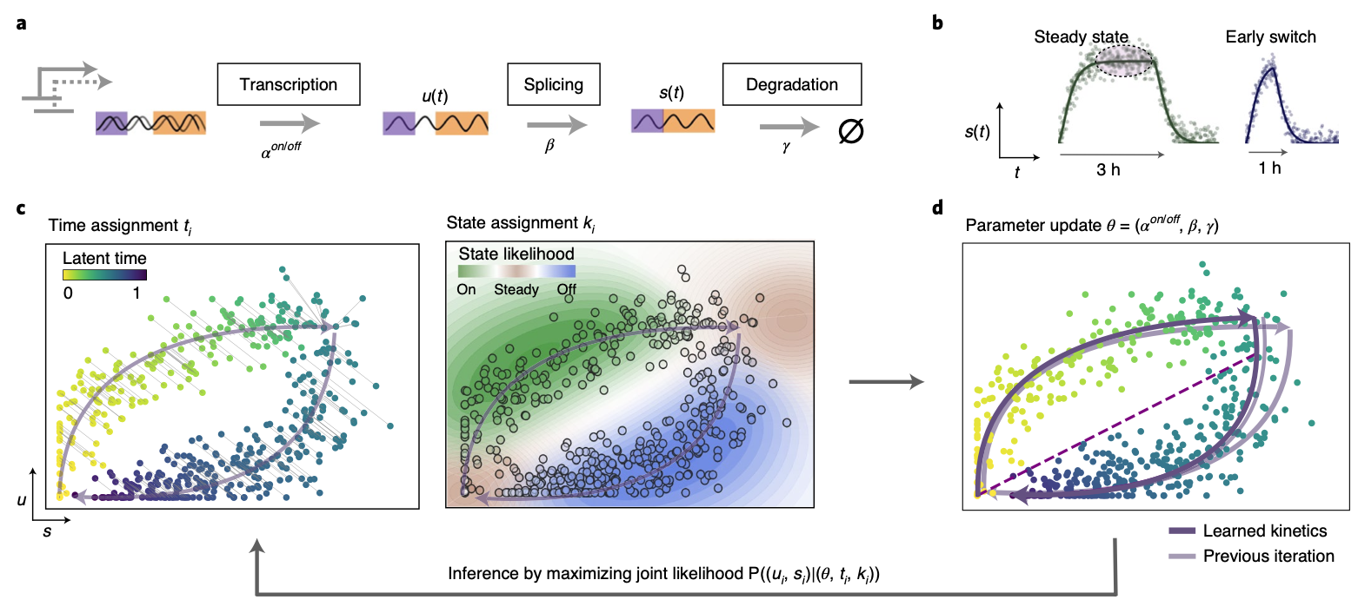
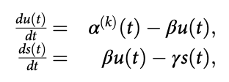
scVelo have a slightly different model.
But its outcome is often similar.

Slide 23
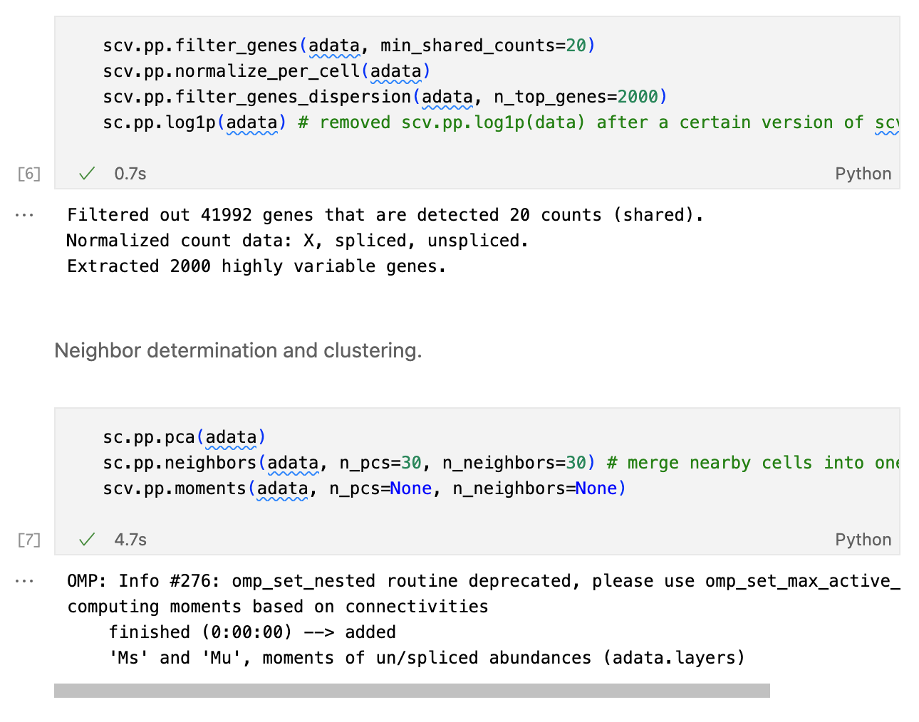
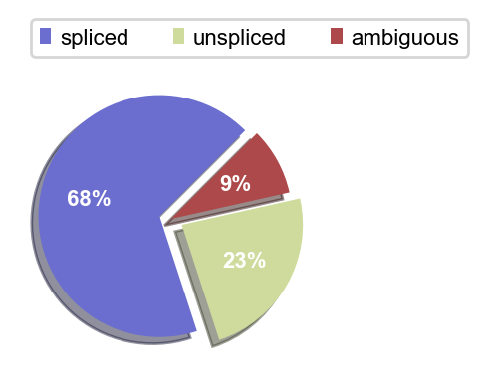
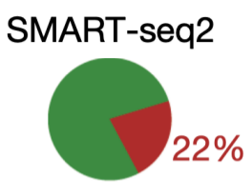
Preprocessing.

Slide 24
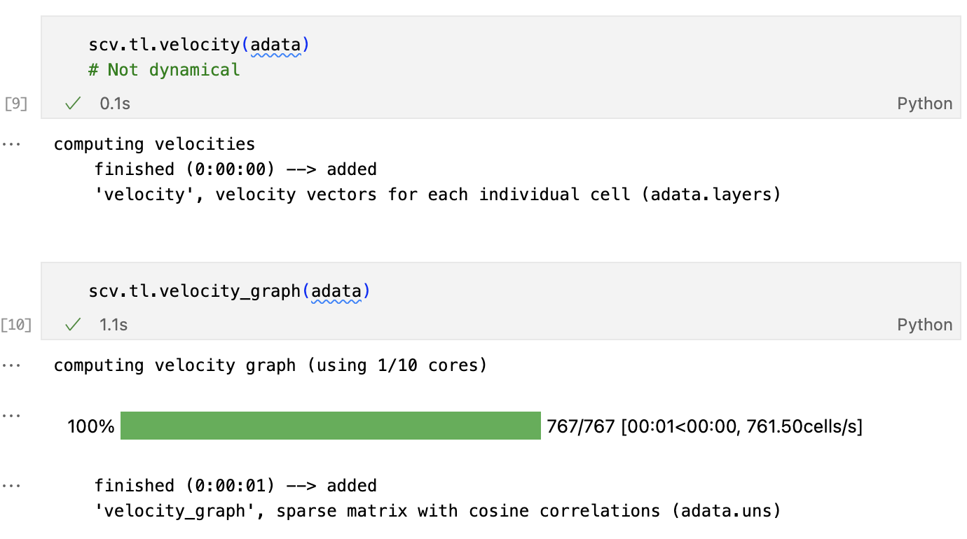
Calculation of velocity.

Slide 25
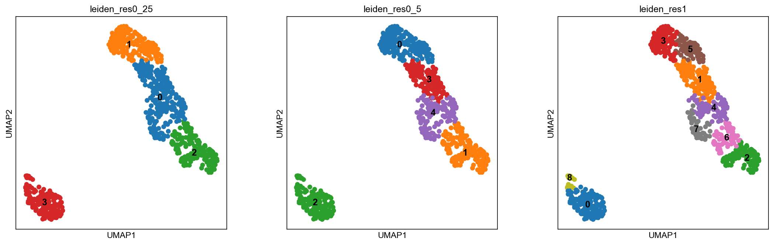
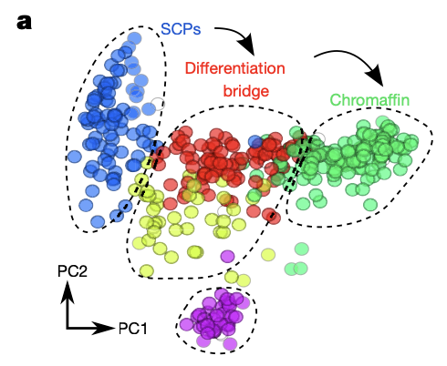
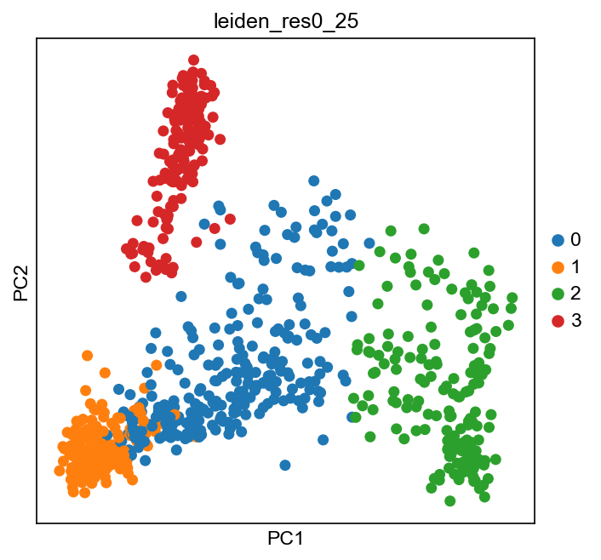
Dimension reduction with UMAP.

Slide 26
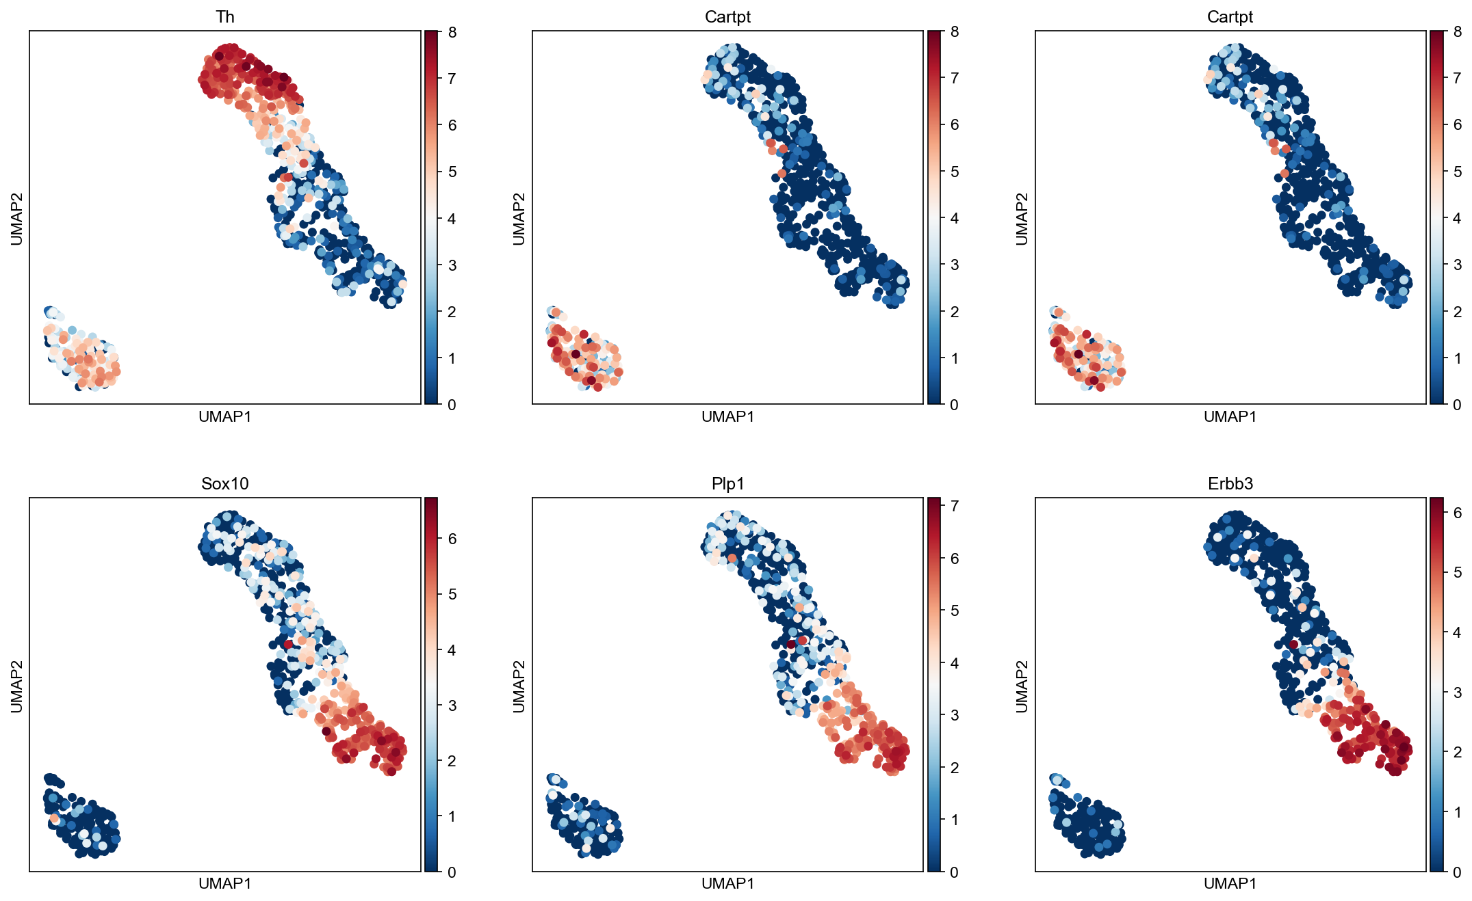
Manual cell type assignment.
Schwann Cell Precursors
+: Foxd3, Sox10, Plp1, and Erbb3.
Sympathoblasts
+: Slc18a3, Cartpt, Th.
Chromaffin
+: Th, Phox2b, Chgb.
-: Slc18a3, Cartpt.

Slide 27
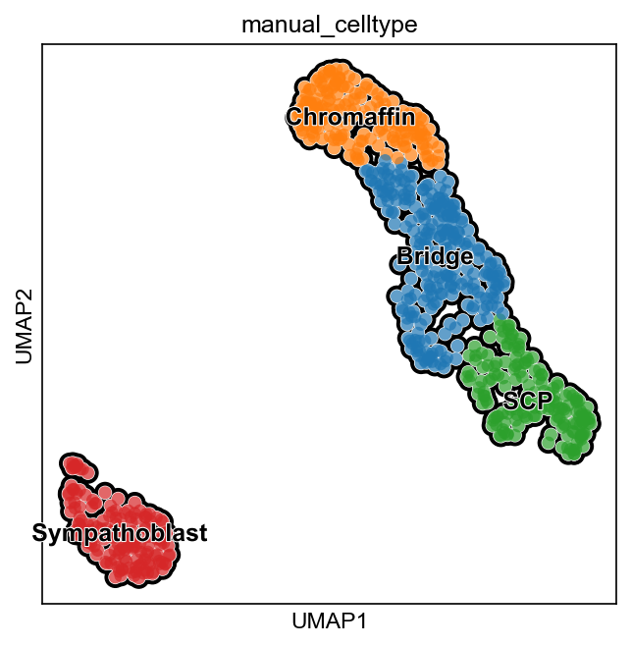
Manual cell type assignment.

Slide 28
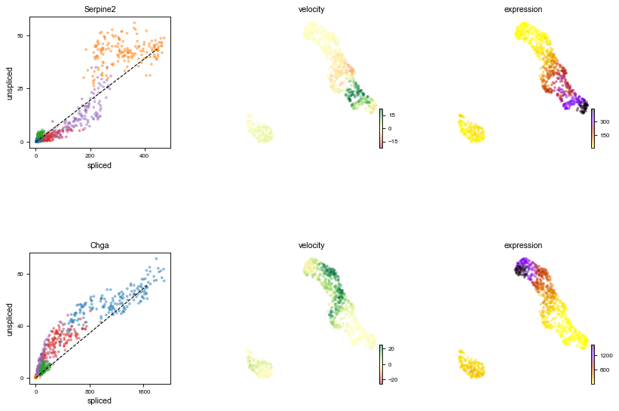
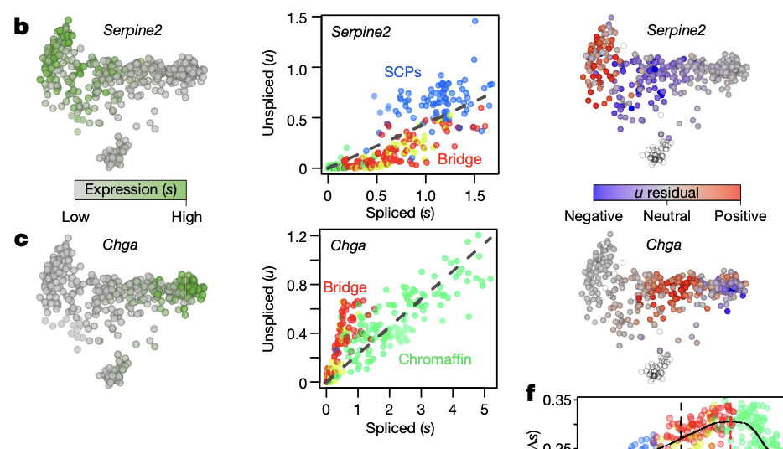
Gene specific phase portraits.

Slide 29
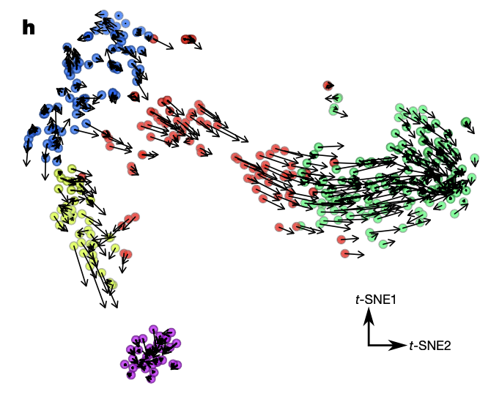
Velocity graph.

Slide 30
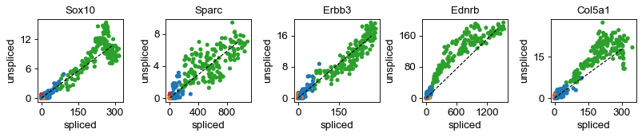
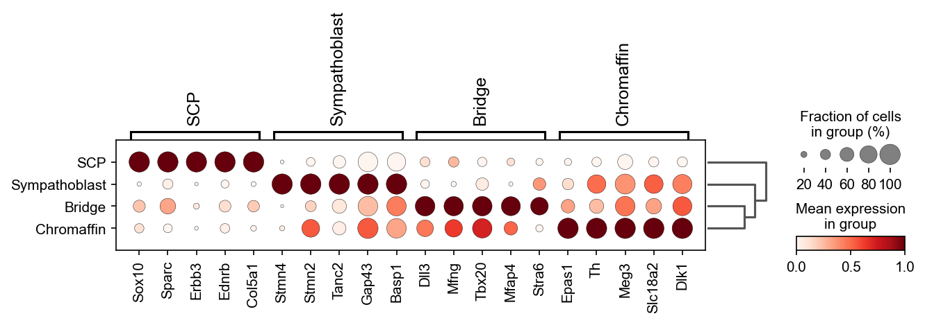
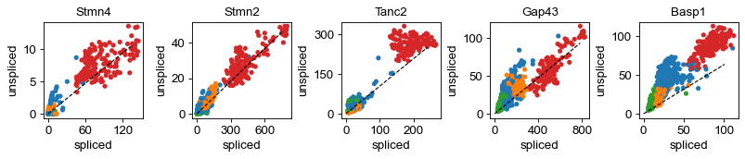
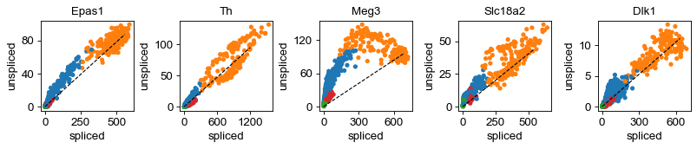
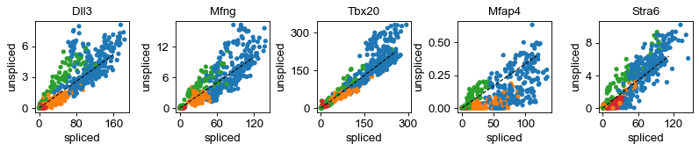
A little further investigation and exploring.

Slide 31
Further Studies

Slide 32
Velocity graph.
Ehhhh....

Slide 33
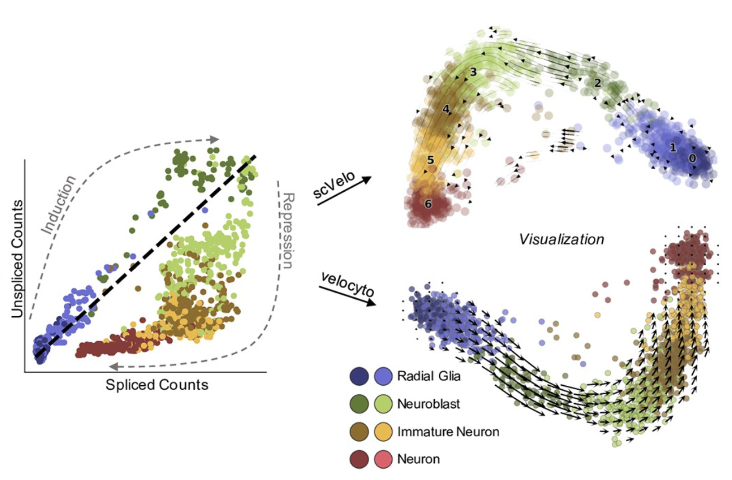
A little problem.

Slide 34
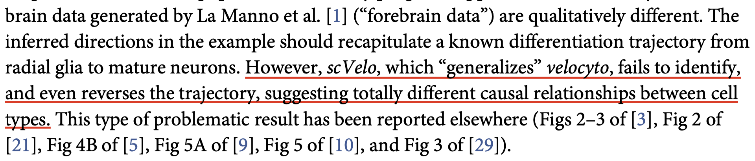
A little problem.

Slide 35
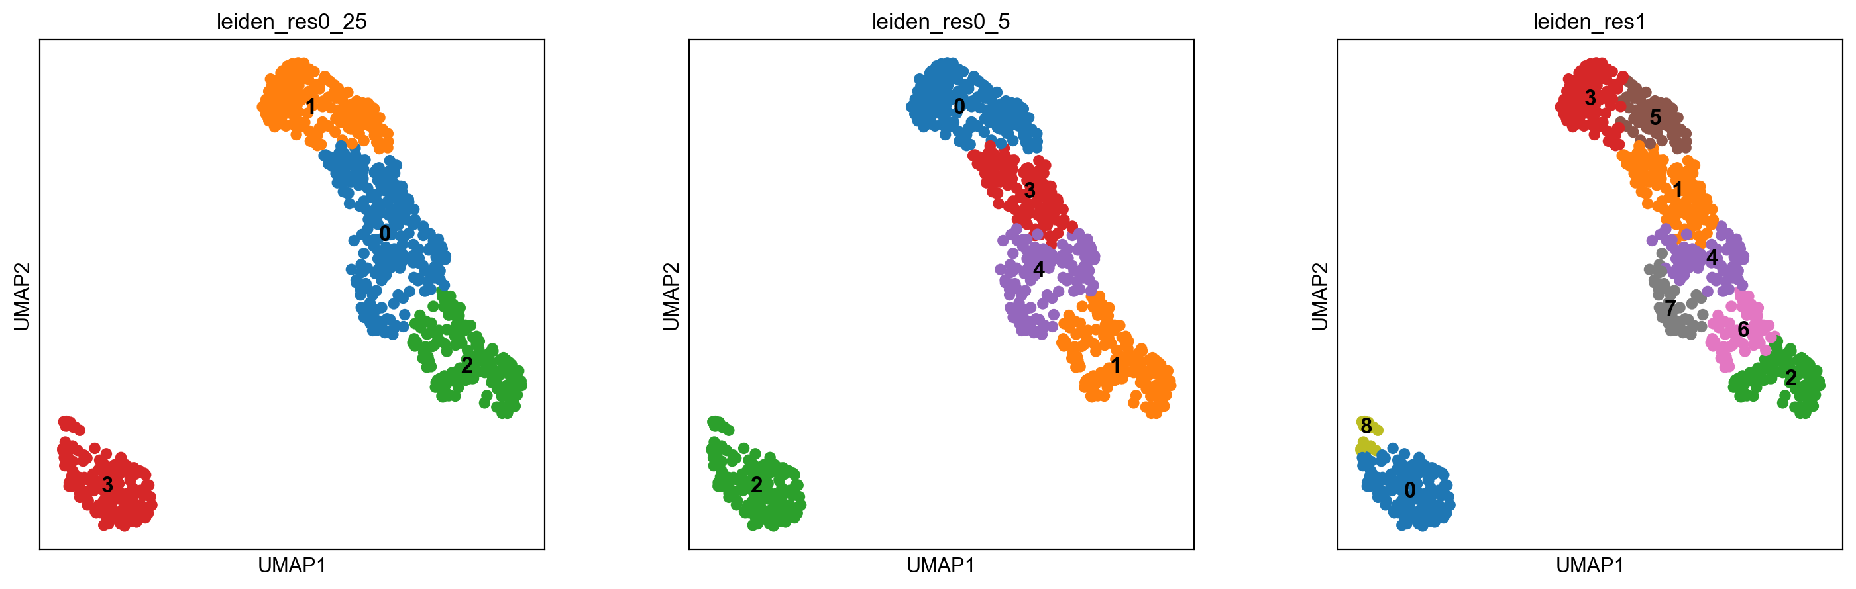
Solution?

Slide 36
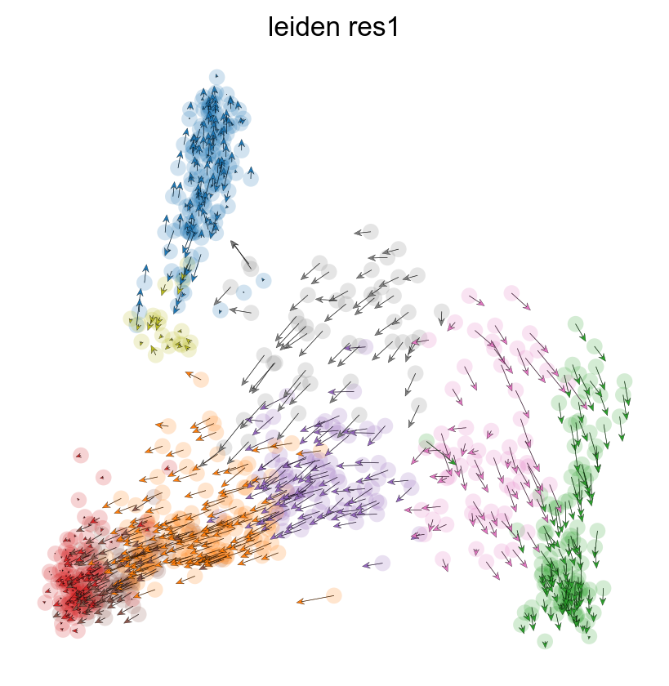


Solution?

Slide 37



Modification of Activation Rate

Slide 38


Modification of Activation Rate

Slide 39
Conclusions
1. Might be very useful.
2. Don’t use very old data if you want to re-do a work.
3. Don’t buy Mac.
4. Studying systems biology might give insights into analysis.
5. Models need to be handled very carefully.

Slide 40
Reference
Bergen, V., Lange, M., Peidli, S., Wolf, F. A., & Theis, F. J. (2020). Generalizing RNA velocity to transient cell states through dynamical modeling. Nature Biotechnology, 38, 1408–1414. doi:10.1038/s41587-020-0591-3
Gorin, G., Fang, M., Chari, T., & Pachter, L. (2022). RNA velocity unraveled. PLoS Computational Biology, 18. doi:10.1371/journal.pcbi.1010492
Manno, G. L., Soldatov, R., Zeisel, A., Braun, E., Hochgerner, H., Petukhov, V., … Kharchenko, P. V. (2018). RNA velocity of single cells. Nature, Vol. 560, pp. 494–498. doi:10.1038/s41586-018-0414-6

Slide 41




Salute! Any questions?

